Slide 1

Randomized algorithms
Divesh Aggarwal
School of Computing
Department of Computer Science

Slide 2
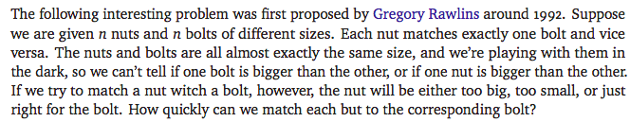
Nuts and bolts

Slide 3

Nuts and bolts

Slide 4

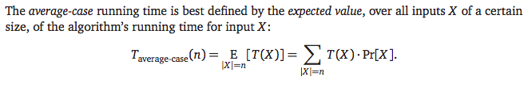
Deterministic vs randomized algorithms
But this definition makes an assumption on the input distribution

Slide 5

Randomized algorithm (worst-case input)

Slide 6


Back to nuts and bolts
Let us look at the problem of finding a nut that matches a given bolt
Suppose we pick a random nut from the untested nuts
So, if k nuts are left to test, each is chosen w.p. 1/k

Slide 7
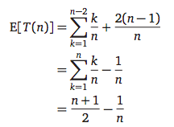
Expected running time

Slide 8


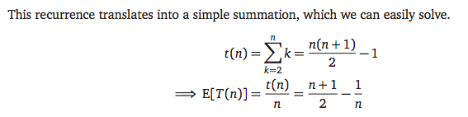
We can think of the algorithm recursively

Slide 9

Finding all matches
Trivial algorithm requires O(n²) comparisons.
Choose a pivot bolt, and test it against every nut.
Then test the matching pivot nut against every other bolt.
After 2n-1 comparisons, we have one matching pair and the remaining are partitioned into two sets: smaller and larger than matching pair
The worst-case number of tests made by this algorithm is given by the recurrence
We know this recurrence solves to T(n) = O(n²)

Slide 10
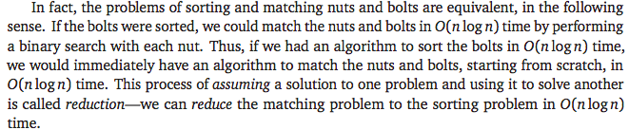

Equivalence to sorting
Note that we can’t use mergesort if they weren’t matched since we are only allowed to compare nuts with bolts, and not nuts with nuts

Slide 11

Choosing pivot at random: analysis
We can solve this recurrence to get T(n) = O(n log n)!
See textbook for a solution to the recurrence

Slide 12




Alternative (iterative) analysis

Slide 13
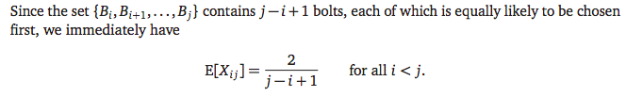
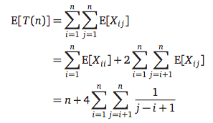
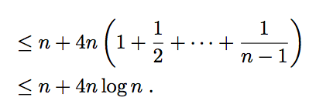
Alternative (iterative) analysis

Slide 14
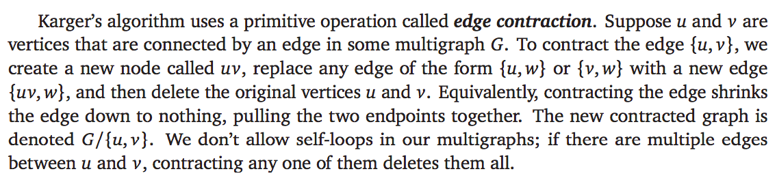
Edge contraction
Consider the problem of min-cut for a multi-graph (a pair of nodes can have multiple edges between them)
Contracting an edge increases the minimum cut size if and only if that edge is part of every minimum cut.

Slide 15
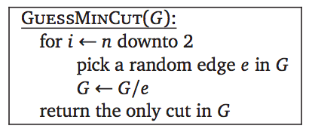
A randomized algorithm for minimum cut

Slide 16
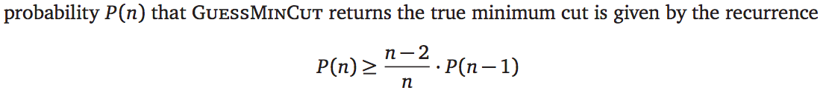
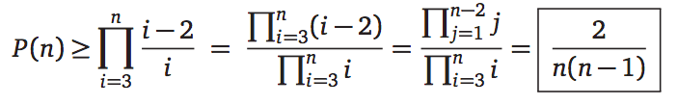
Success probability
Suppose G has a min-cut of size k
Each vertex must have degree at least k.
The number of edges in the graph is at least kn/2.
The probability that a min-cut edge is chosen is at most k/(kn/2) = 2/n

Slide 17
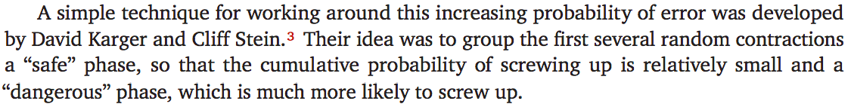
Better algorithm: not-so-blindly guessing

Slide 18
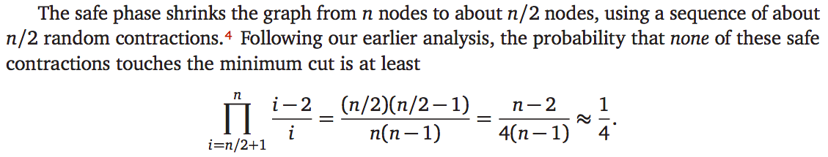
Better algorithm: not-so-blindly guessing

Slide 19
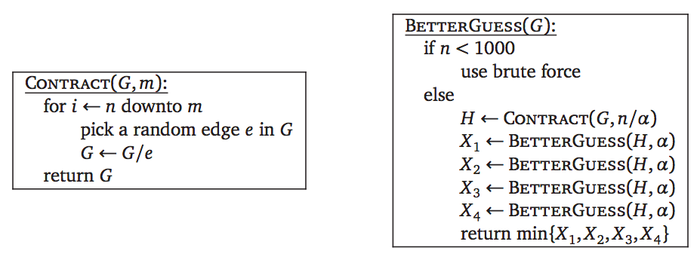
Better algorithm: not-so-blindly guessing

Slide 20
Better algorithm: not-so-blindly guessing

Slide 21
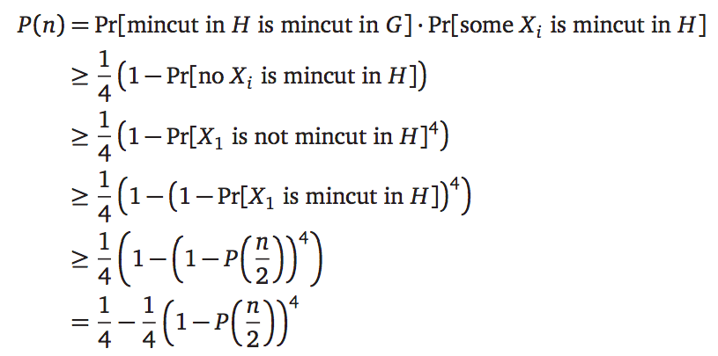
Success probability

Slide 22

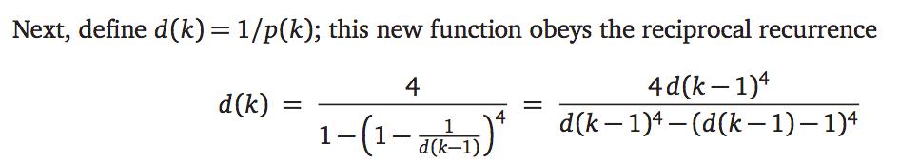
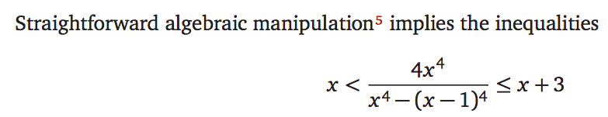
Success probability

Slide 23
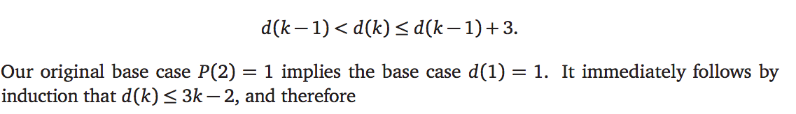

Success probability

Slide 24
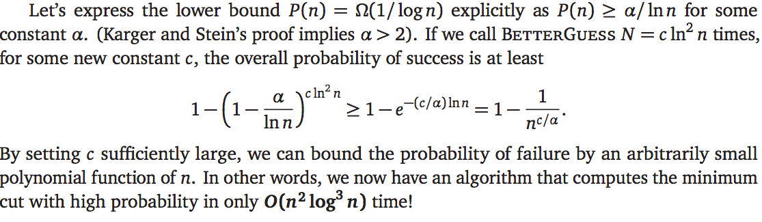
Success probability

